Slide 1
JASP
Zachery Dyer, Blake Andrews & Bayley Fisher
He/Him
He/Him
He/They

Slide 2
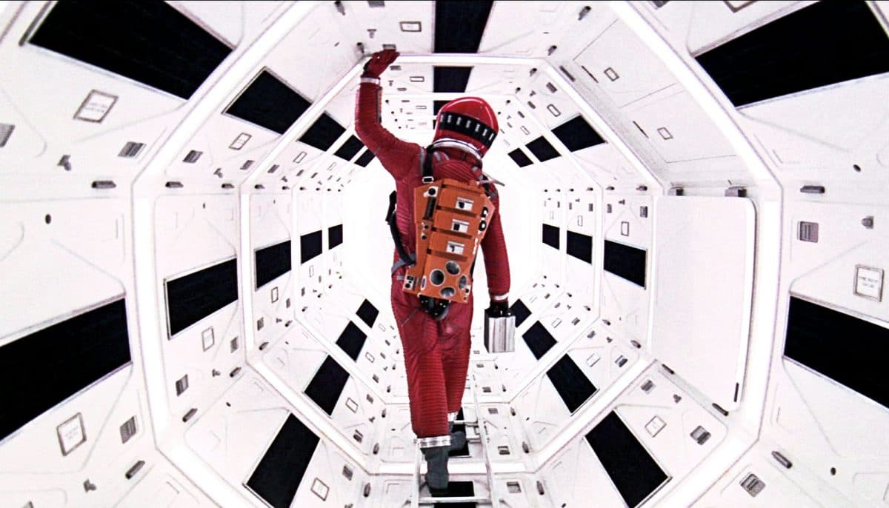
Overview
‘Jasp’ is a third-person wave-like space shooter.
Put’s the player into the majestic void of space with only their StarShip and blasters, trying to fight off enemy attack ships that are trying to hinder and destroy the player.
Inspired by the likes of Space Invaders and Galaga, but in a 3D environment.
Blue & Orange to highlight the distinction between the world, the player and its enemy.

Slide 3
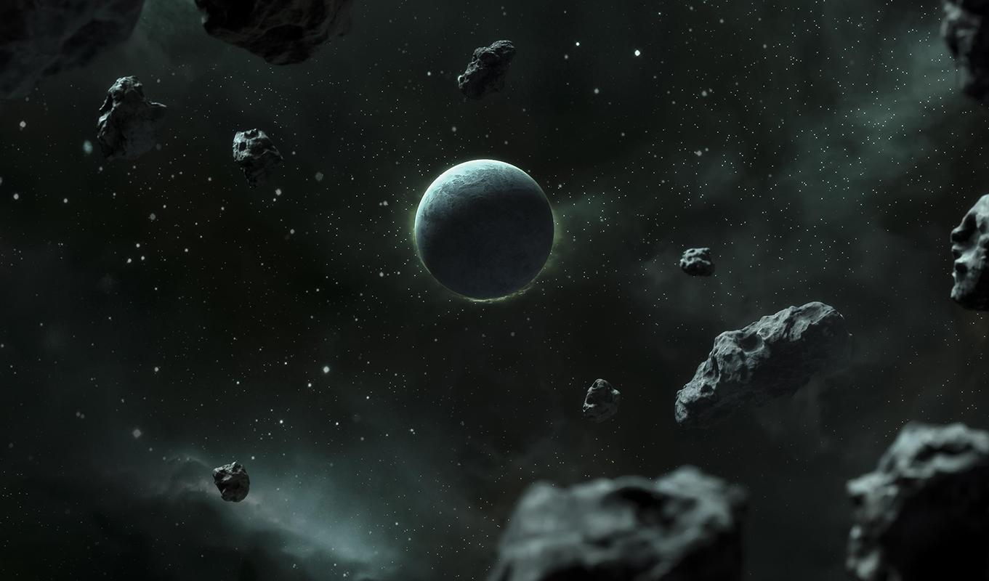
Gameplay
The game consists of an infinitely growing wave system that makes the game progressively get harder as the player tries to survive as long as possible against the enemy ships and asteroids.
The goal of the player is to survive as long as possible.
Game Over when the player loses - there is no win condition.
Score system earned by destroying ship types.
The main ship is given full control to the player via omnidirectional controls, including pitch, yaw and roll.

Slide 4
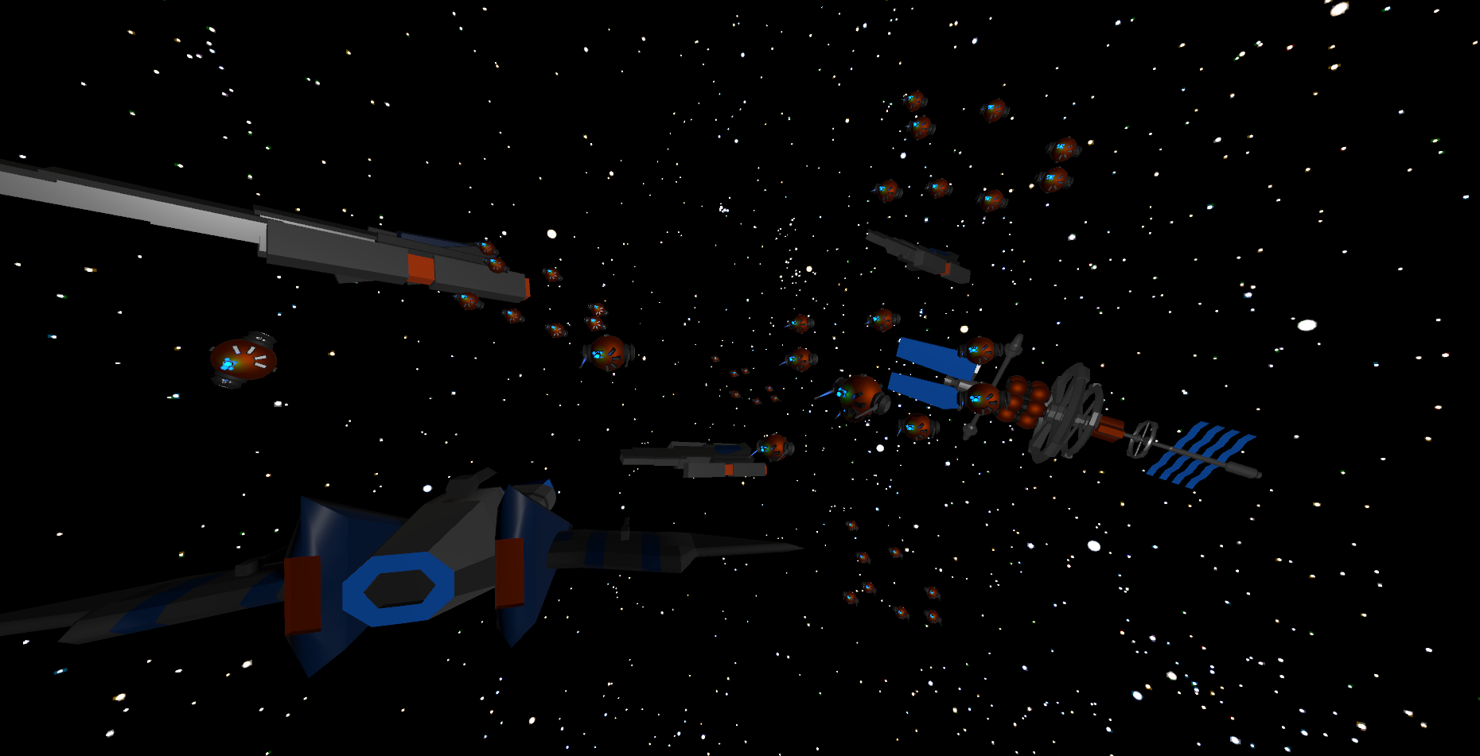
Core Mechanics
The player is able to control the spacecraft with acceleration and deceleration, including pitch, yaw and roll.
The player can shoot two simultaneous turrets, one slow firing cannon and dispense “space bombs” from behind.

Slide 5
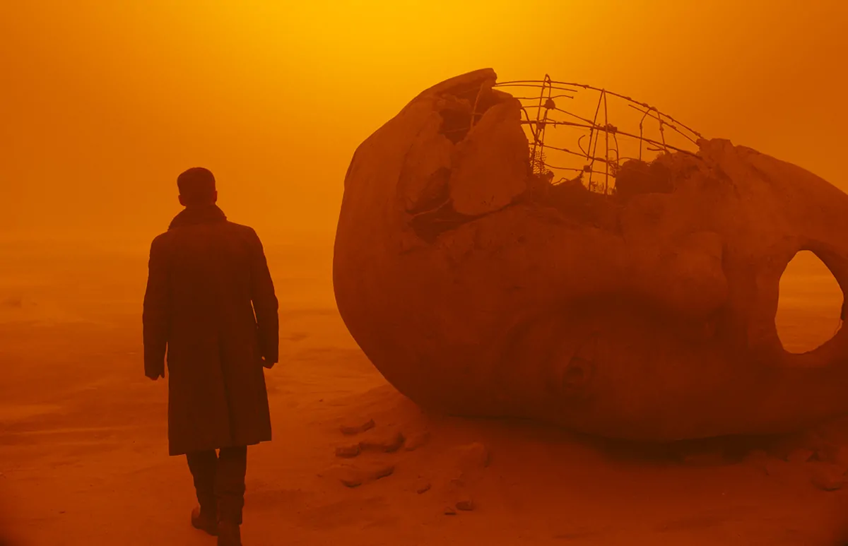
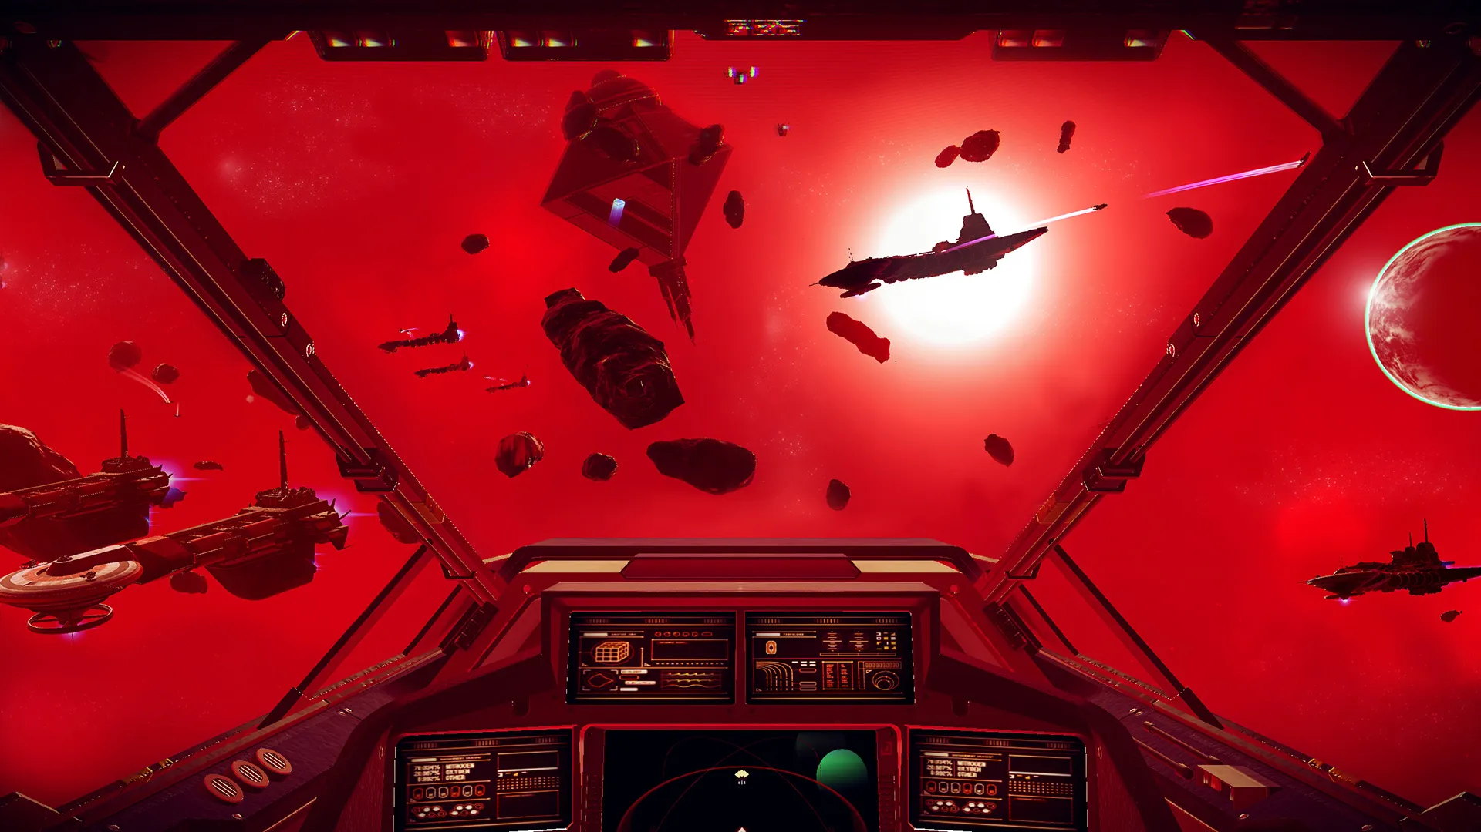
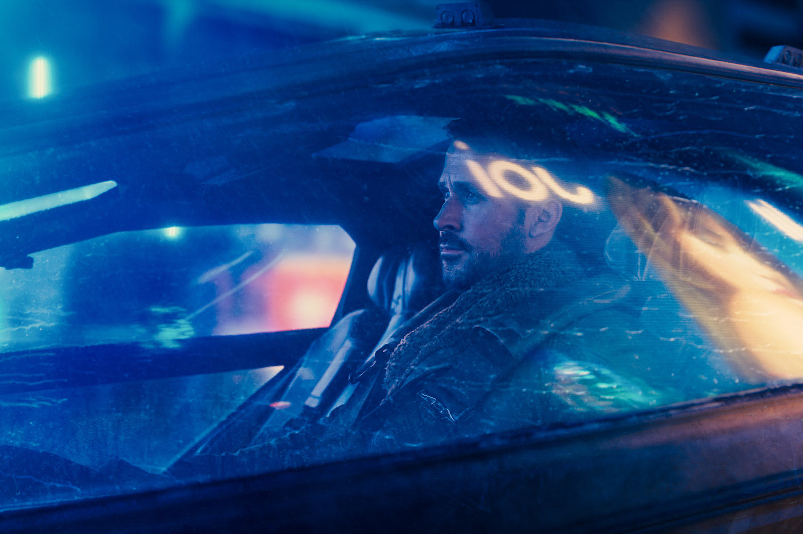
Level Overview
Contrasting colours to highlight the distinction between the world and the player.
Single open area filled with asteroids, enemy spaceships and space stations.
Entire level is built upon the enemies spawning in any direction - so the player has to always be moving.

Slide 6
Sound | Filename | Loop | Variations | Notes
Player Ship Fly | player_fly_(flyType)+(flyType) E.g., player_fly_F+Y | Yes | 4 | Flying, pitch, roll, yaw
Playing Accelerating | player_accel | Yes | 1 | Played when the player accelerates
Player Dodging | player_dodge | No | 1 | Whoosh effect when a player dashes a specific direction
Player Taking Damage | player_hurt | No | 1 | Rattling metal when the player is shot
Player Exploding | player_death | No | 1 | Explosion effect when the player dies in any way
Asteroid Exploding | ast_death | No | 1 | Rubble explosion
Enemy Exploding | enemy_death_(enemyType) E.g., enemy_death_airwing | No | 4 | There are four different enemy ships
Player Shooting | player _shoot_01 | Yes | 2 | Two different shoot sounds - turret & cannon

Slide 7
Soundscape
Movement in space for the Starship is reminiscent to that of a roaring aircraft, but tonally softer - and more of a thrum of futuristic electrical components.
Acceleration of the spacecraft sounds like a punchy, sputtering of an aircraft, while deceleration is like a vacuum being turned off, as the components turn off and quieten down over a longer period of time rather than instantaneously.
The sound design specifically for the main player turrets is created using a synthesizer - a stereotypical “pew-pew” sound for the front firing turrets, while the main canon is a sort of roaring electrical ball of energy that sounds like a booming soundwave.

Slide 8
–Brodie Frazer (2023)
“You have to be an idiot to not think there’s other life out there. It’s one thing to question your own existence, it’s another thing to question if there’s more life outside of the Cosmos”

Slide 9
Q&A

